Slide 1
Developer Services Making Developers Successful
Marsh Gardiner, Products
@earth2marsh
Bala Kasiviswanathan, Products
@BalaK

Slide 2
Agenda
Build, enable and engage your developer community – Documentation
Deploy business models for your API products
Build, enable and engage your developer community – Onboarding & Analytics

Slide 3



Apigee Edge – Developer Services
Developer Services
Developer
Engage internal & external developers and monetize APIs
API Team
Analytics Services
Visibility from the app-end to the back-end
Business
User
API Services
Great APIs and apps fast
App
Backend
Notes:
Main Points:
Apigee Enterprise delivers the most comprehensive set of tools to support your Mobile Value Chain.
Script:
API Layer to securely transform backend services to easily consumable APIs to accelerate app development
Developer Layer to enable, engage and transact with your developer community (represented by the gray people graphics)
Data Layer to provide visibility from the app-end to the backend for business and technical teams

Slide 4
Introducing: API Modeling & Smart Docs
Notes:
Hi, I'm Marsh, and I work on the product team with Bala. Today I am super-excited to announce a new addition to the Apigee platform—API Modeling and Smart Docs.
Situation: Building and maintaining API documentation is a constant struggle.
Complication: Too often docs are an afterthought, meaning they're either incomplete or out of date, creating a bad developer experience that is a drag on your API adoption.
Implication: Since the developer experience begins with your documentation, you should be doing the exact opposite, and helping developers get up to speed faster.
Position: We can help you reconcile the machine-friendly structure of your API with the information people need to use your API.
Action (opening): In the next few minutes, think about how much this can help your developers as they try to understand how your API works.

Slide 5
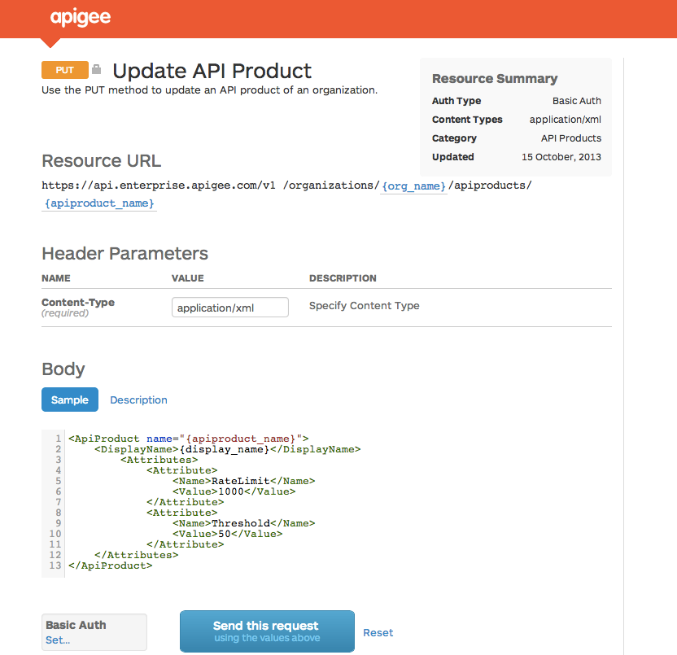

A better way to document APIs
API Modeling
Describe an API structure
Smart Docs
Generate beautiful, interactive documentation
Notes:
API Modeling is a central service that holds the machine-structure of your API, and it uses that structure to organize all related metadata for your API.
That API model then generates detailed API docs that developers need to be successful.

Slide 6
Agenda
API Modeling
API Documentation
Portal Integration
Notes:
API Modeling is a central service that holds the machine-structure of your API, and it uses that structure to organize all related metadata for your API.
The API Doc Generator takes that model and renders it into detailed API docs that developers need to be successful.

Slide 7



Populating an API model
API
Description
API Modeling
< />
{…}
Notes:
There are plenty of great tools for generating API descriptions from source code. For instance, if you’re using Jersey, it’s easy to generate a WADL from your annotations, or you could use Apache CFX or Enunciate.
If you prefer JSON you can use the excellent Swagger framework to create a JSON-based description.
Now what are these descriptions? They’re XML or JSON formats. And think about what XML and JSON are used for—to serialize an object so you can send it across the wire. There are lots of competing formats in the world right now, and the last thing the world needs is another one. So we’re taking a different approach. We’re not particular about format, but we are particular about all the awesome things you can do with the objects they represent. Today we support WADL and we’re launching beta support for Swagger descriptions. Over time we’ll be adding other popular description formats.
Of course, API Modeling is also powered by APIs, so if you prefer, you can skip the interim step and work directly with the modeling services.

Slide 8



Host anywhere
Model-generated docs
Apigee Edge – Developer Services
Other CMS
gh-pages
Notes:
Now we have big, big plans around API modeling and the ways in which it makes Apigee Edge more powerful. But today, I want to talk just about how you use it to generate awesome API documentation.
As soon as describe your API to Apigee, the backend begins generating your docs. You can think of this as a static-site generator, something like Jekyll. You can take all those HTML docs and host them anywhere you like—Drupal, your own CMS, or even on a GitHub hosted-pages repo. Of course, it works out-of-the-box with our Developer Services portal.

Slide 9
Detail-rich methods
Interactive
Docs that learn
Notes:
Ok, enough slides. Let me show you what is so great about these docs and how easy they are to publish.

Slide 10
DEMO

Slide 11
A better way to document APIs
API Modeling
Describe an API structure
Smart Docs
Generate beautiful, interactive documentation
Notes:
API Modeling is a central service that holds the machine-structure of your API, and it uses that structure to organize all related metadata for your API.
That API model then generates detailed API docs that developers need to be successful.

Slide 12
Apigee Edge - Developer Services
Deploy business models for API Products
Revenue models Create new sources of business
Rate plans Enable levels of service
Monitoring Manage usage limits
Notifications Automate capacity management
API-based access Integrate with existing systems
Developer Services
Charge
Monitor
Bill
Developer
Onboard
Authenticate
Engage
Collaborate
API Team
Notes:
Main points:
Apigee Enterprise delivers the unique capability for Monetization of your API Products directly from within the Developer Services.
Script:
Apigee Enterprise Monetization Services is the answer for the market needs and problems we just talked about.
Digital assets are the new way to grow your business. Enable flexible pricing, billing and revenue models to suit your business.
Apigee Monetization Services is built on Apigee Enterprise and is highly-scalable. This is not a replacement to your accounting systems. This is a complimentary set of tools to enable you to bill for the usage of your API products.
Businesses enjoy a cost effective, flexible, easy to manage set of tools, while still integrating with existing systems. Developers can seamlessly purchase/manage plans, view reports, and billing documents via the a portal.
You can choose from different revenue models
..and from a variety rate plans that work best for your customers.
Manage usage limits and notify customers when they are reaching those limits.
Manage reports and monitor payments to make sure that everything is on truck
Update customers about new API versions available to them and new API products that they may want to use.
Since it’s all API-based you won’t need to replace any of your existing systems.

Slide 13
DEMO

Slide 14
Apigee Edge – Developer Services
3. Build, enable and engage your developer community
Developer Onboarding Streamline API adoption
Community Build an active community
Content Management Blogs, Tutorials, Documentation
Analytics Provide developers visibility
Developer Services
Charge
Monitor
Bill
Developer
Onboard
Authenticate
Engage
Collaborate
API Team
Notes:
Main Points: Developer Services enables you to create a great developer onboarding and community experience to increase adoption.
Tech Points: Enterprise – Developer Services provides the tools that developers expect to see to learn and use your API whether its exploring an API to learn it, or discussing best practices with others in community.
Business Points: Enterprise – Developer Services empowers developers, streamlines their adoption and provides a community that helps their success.
Script:
Developers are the makers in the app economy. Get your developers up and running quickly and efficiently with Enterprise – Developer Services. You will find that it becomes easier and faster for your developers to increase adoption.
Developer Channel Services provide the developer tools needed to connect the API team to application developers. These services help you:
Empower developers with an API Explorer that helps them learn your API with test requests and responses
Streamline the API adoption process with automatic workflow for registration and key management and with the flexibility to adapt to custom registration and key management processes.
Authentication that enables you to onboard developers and maintain compatibility with enterprise authentication standards.
Build an active community for developers that helps them learn from each other and each others work with forums, blogs, and FAQs

Slide 15
DEMO

Slide 16
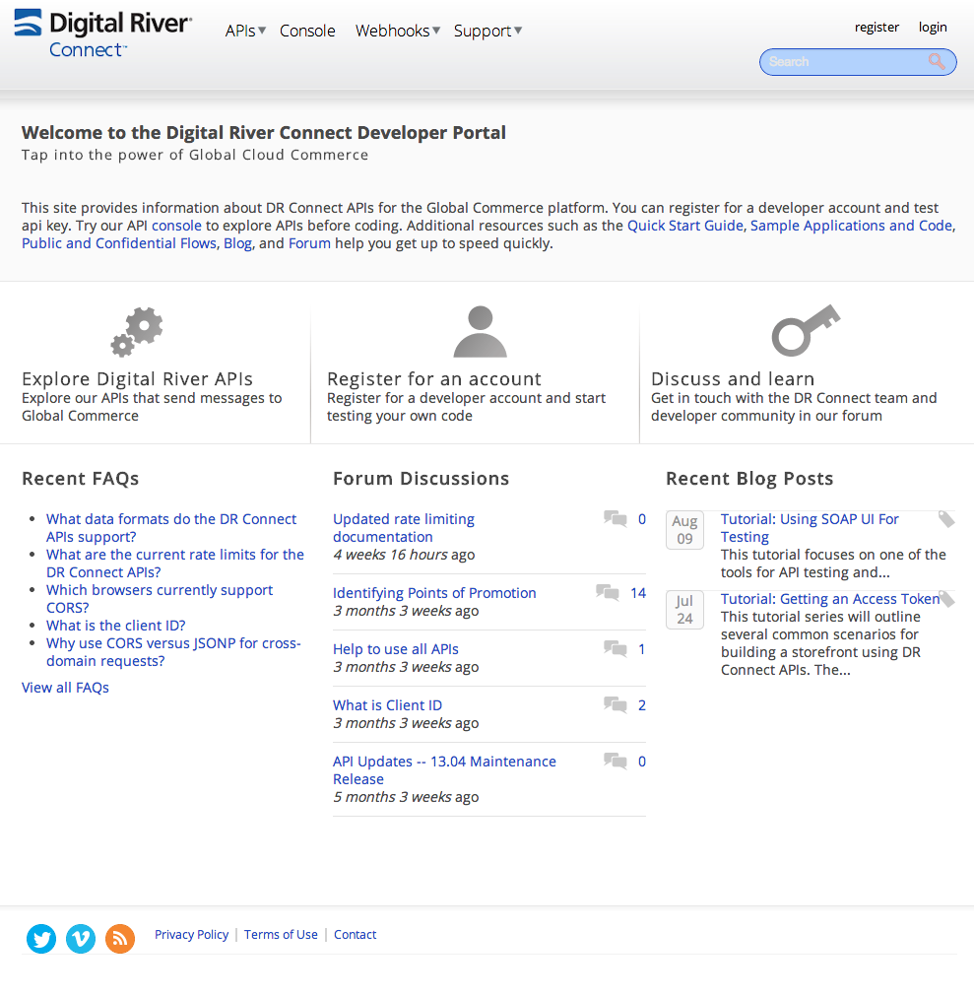
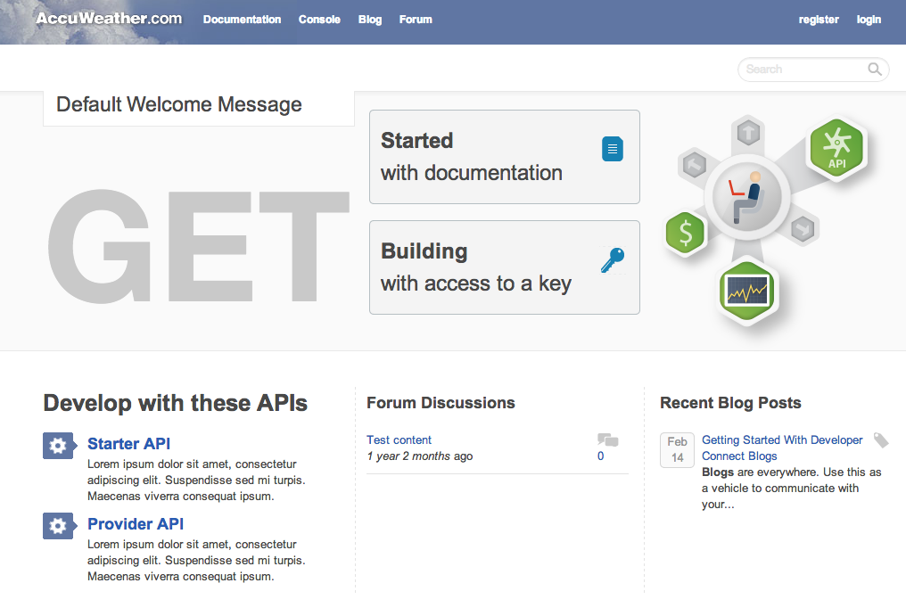

Slide 17
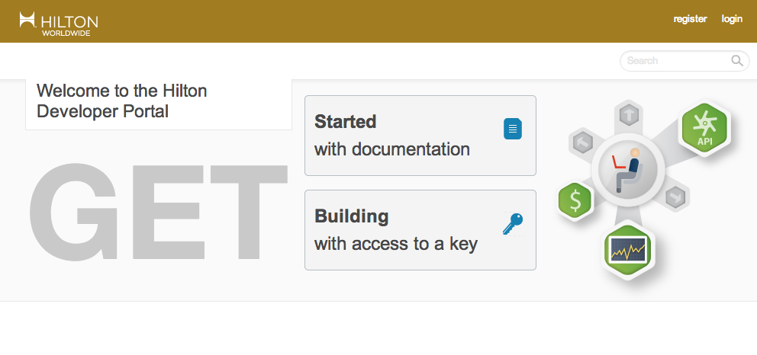

Slide 18
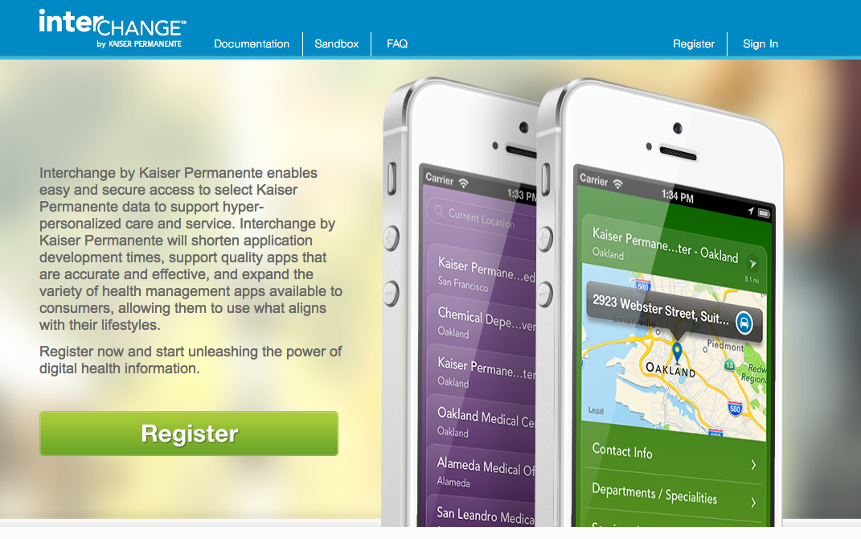

Slide 19
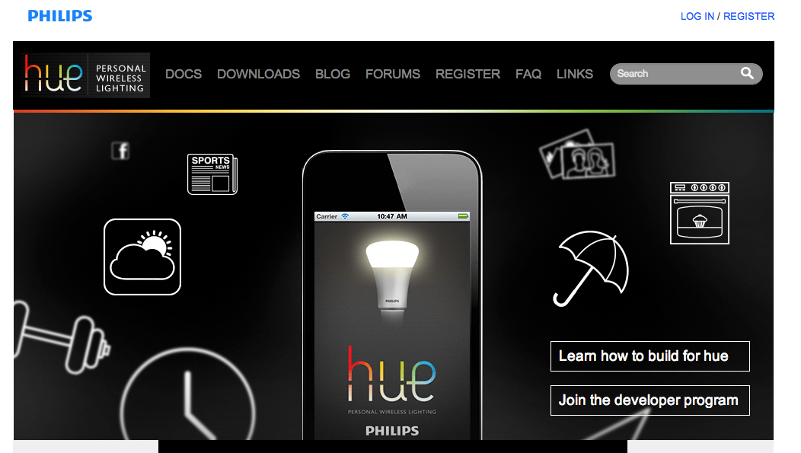

Slide 20
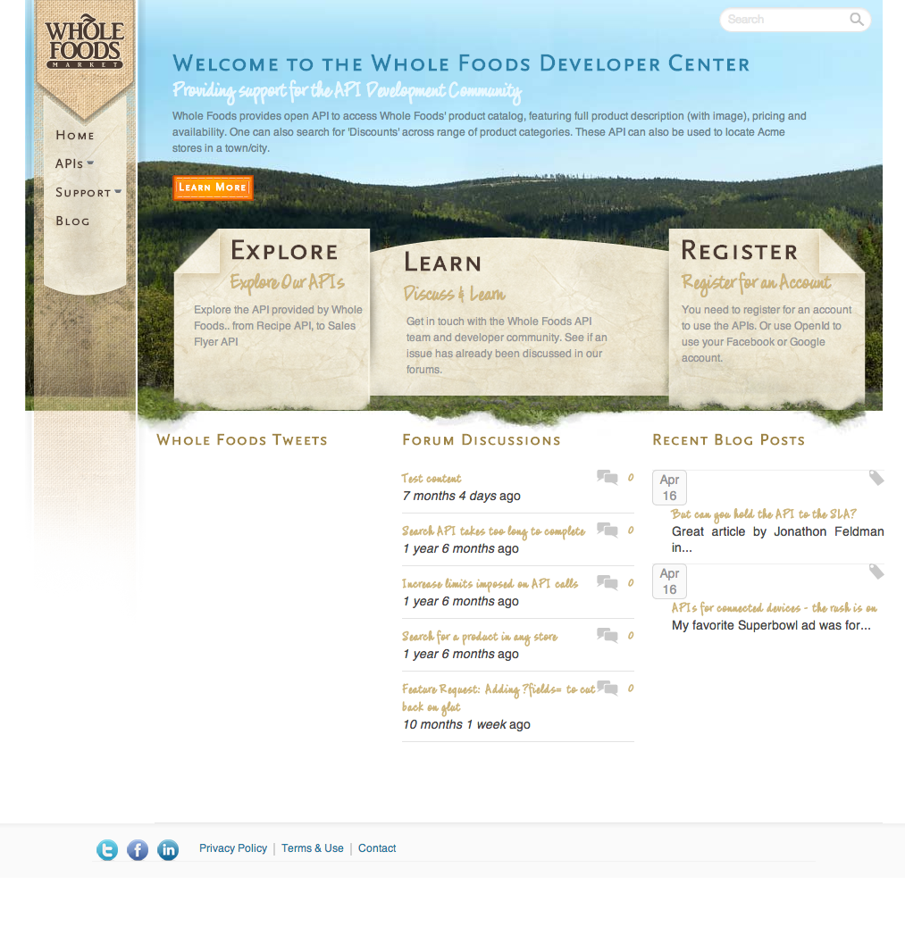

Slide 21
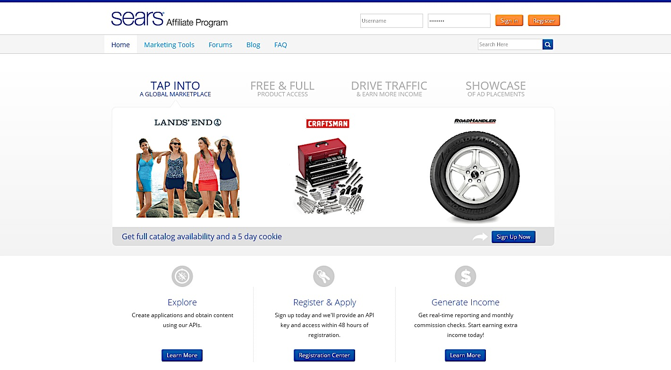

Slide 22
Key Benefits
Securely onboard developers with powerful developer portal and rich documentation
Implement various business models to maximize revenue generation
Provide developers with end-to-end analytics, visibility into charges and revenue

Slide 23
We would love your feedback!
Don’t forget to fill out the session’s survey – found in the session details on the conference app
#iloveapis

Slide 24
Questions

